Slide 1
Decision Intelligence
The Decision-Maker in
Isolation

Slide 2
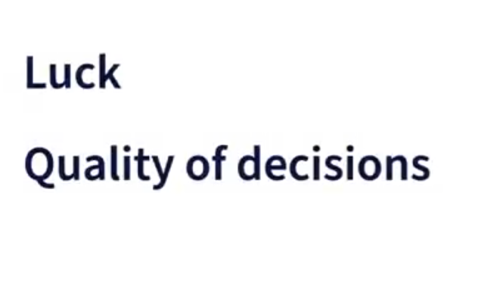

Slide 3
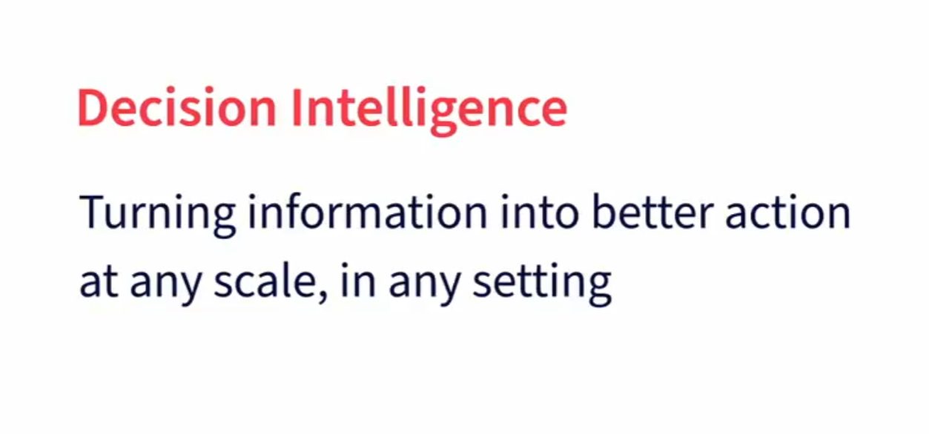

Slide 4
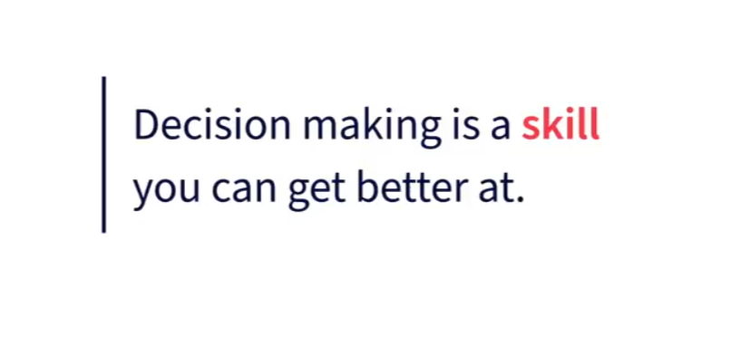

Slide 5
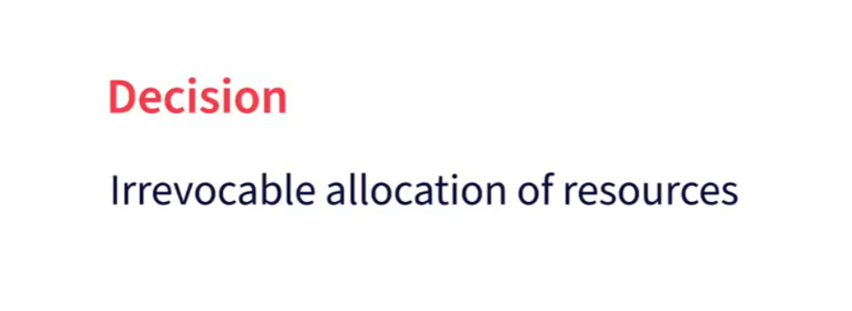

Slide 6
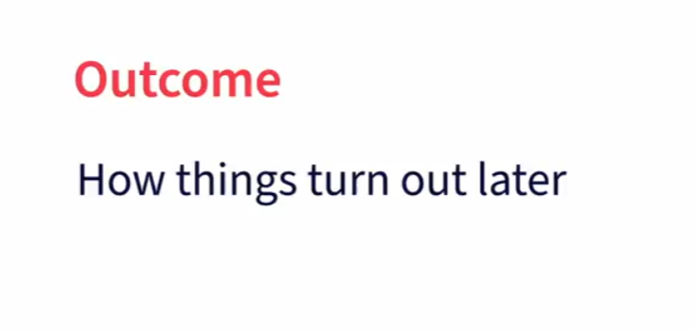

Slide 7
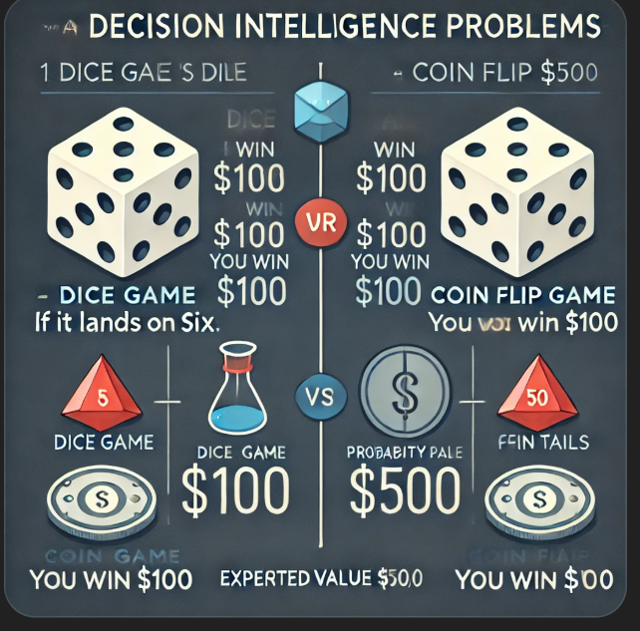

Slide 8
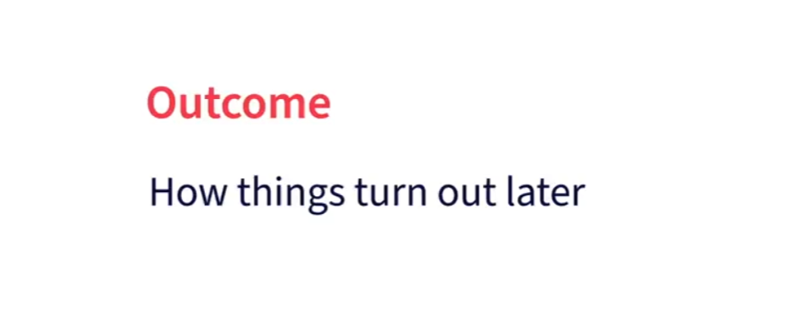

Slide 9
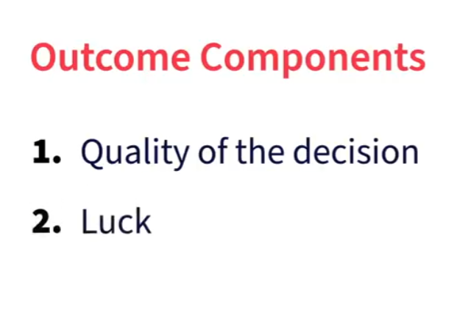

Slide 11
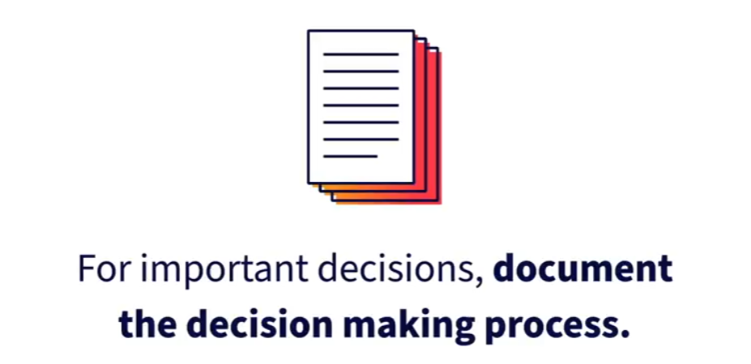

Slide 12
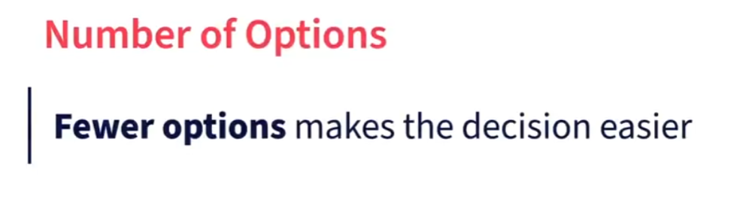
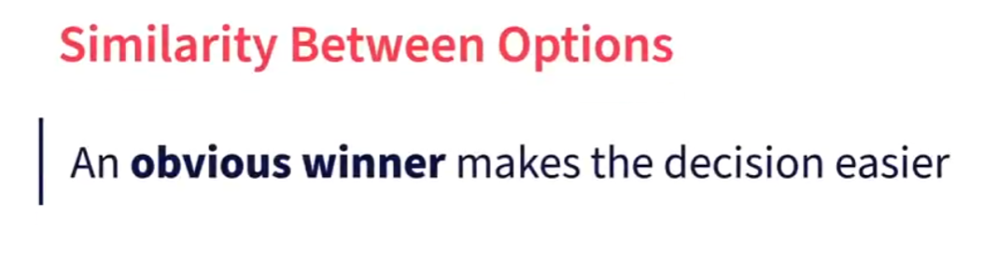
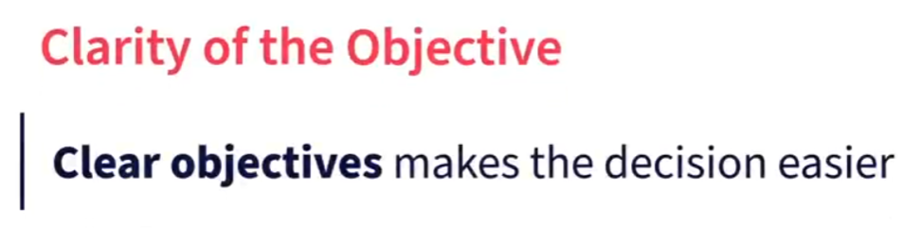
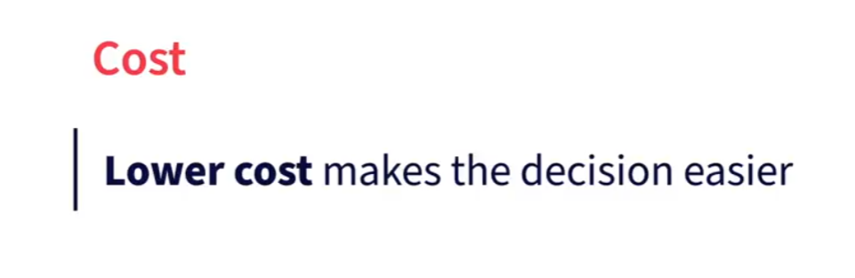
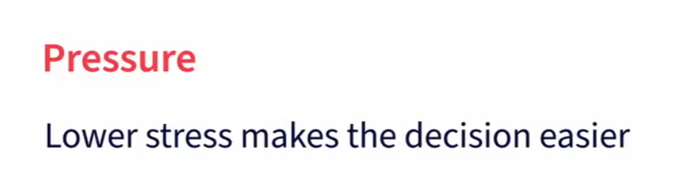
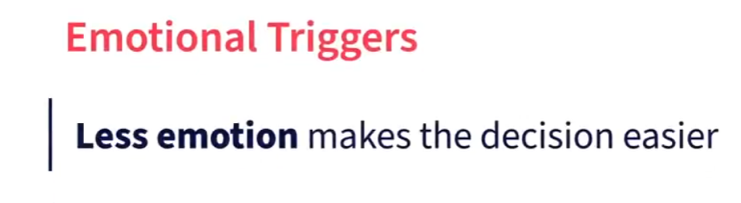
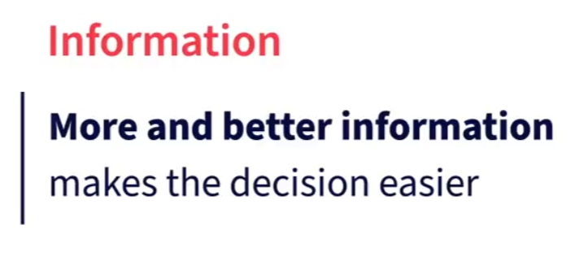
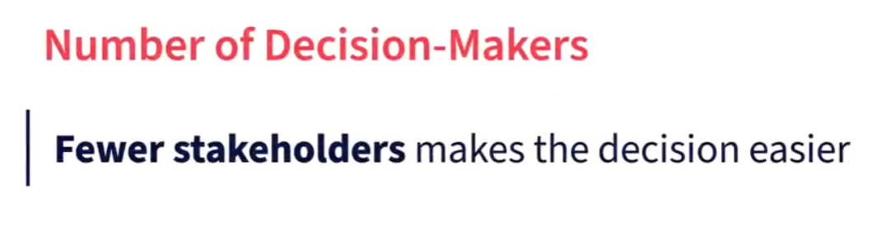
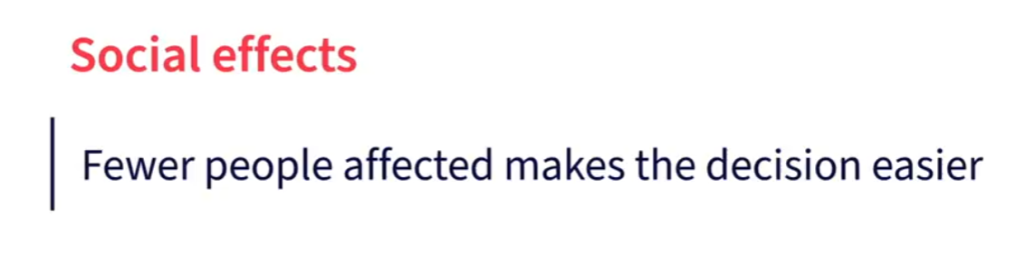
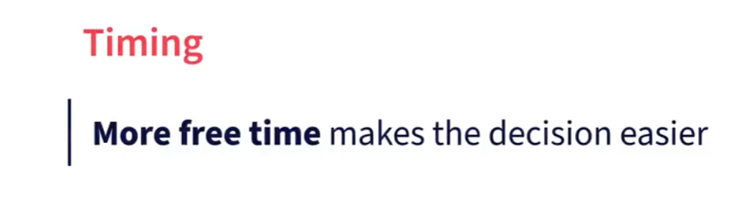
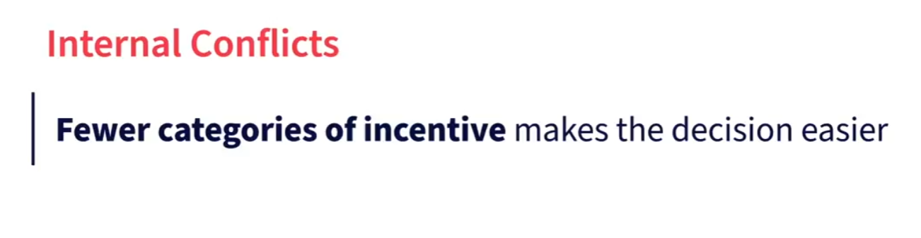
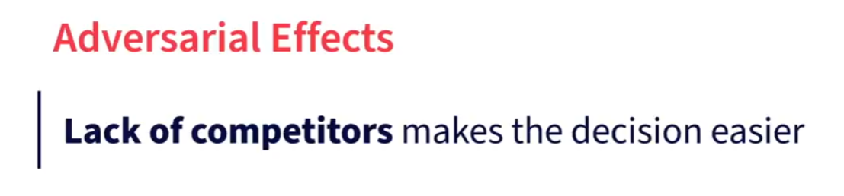
Why are some decisions so difficult?

Slide 13
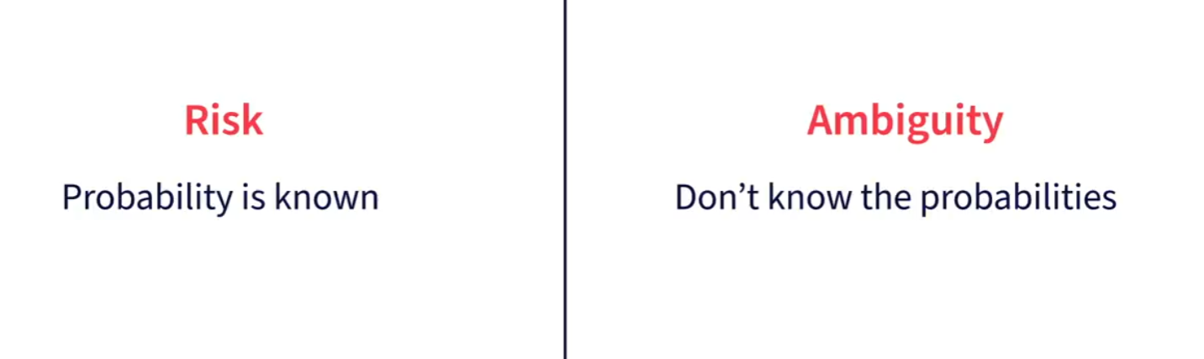

Slide 14

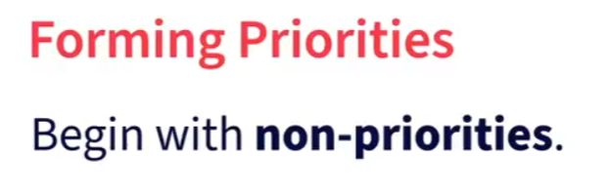
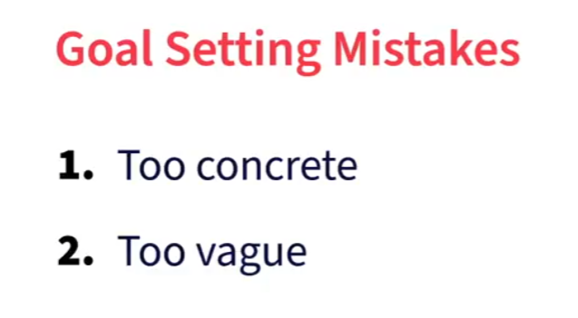
How to set goals

Slide 15
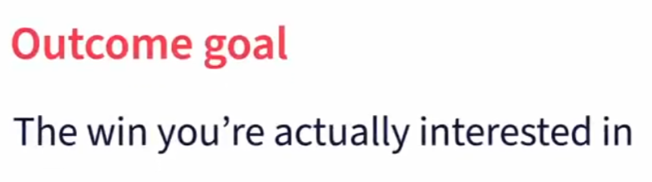
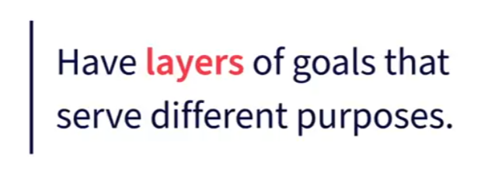
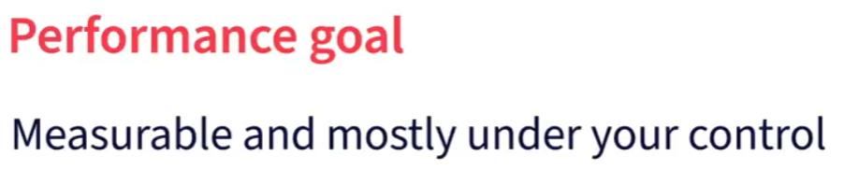
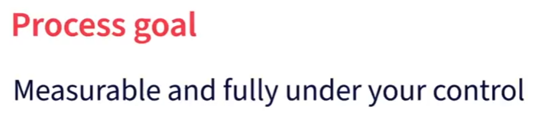
How to set goals

Slide 16
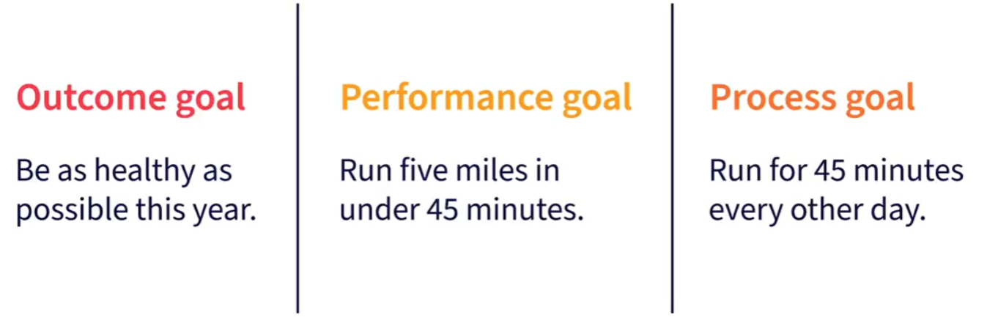
How to set goals

Slide 17
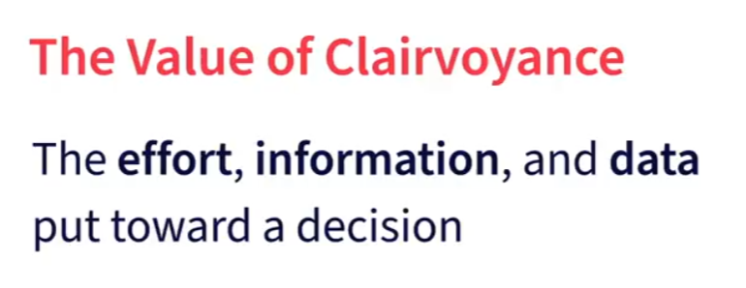
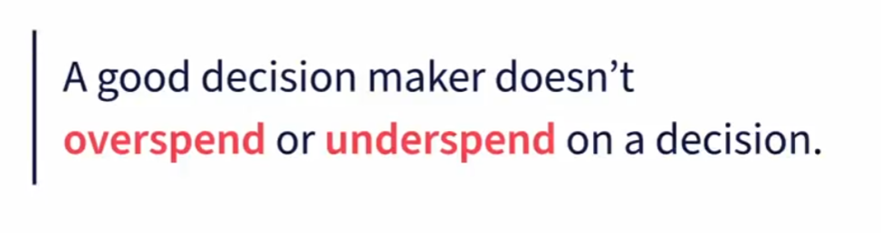
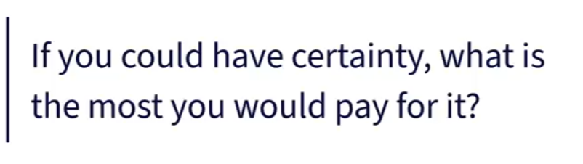
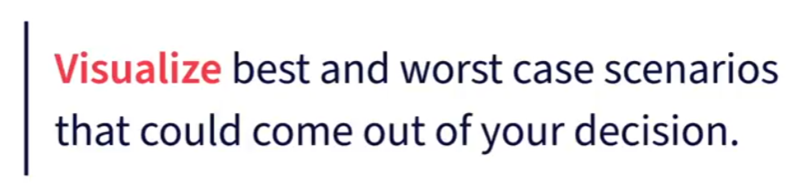

Intuition and the value of clairvoyance

Slide 18
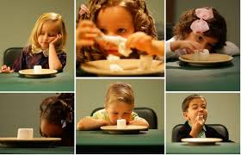
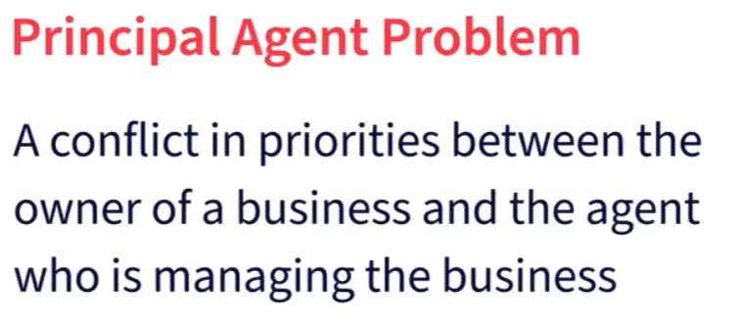
The hackable human

Slide 19
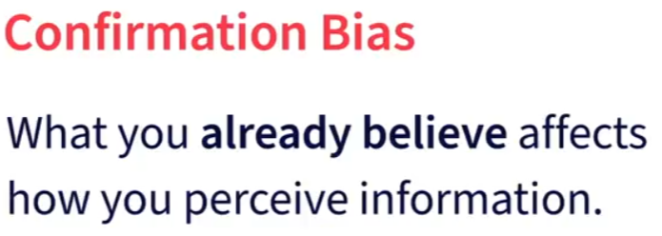

Objective decision-making

Slide 20
Decision Intelligence

Slide 21
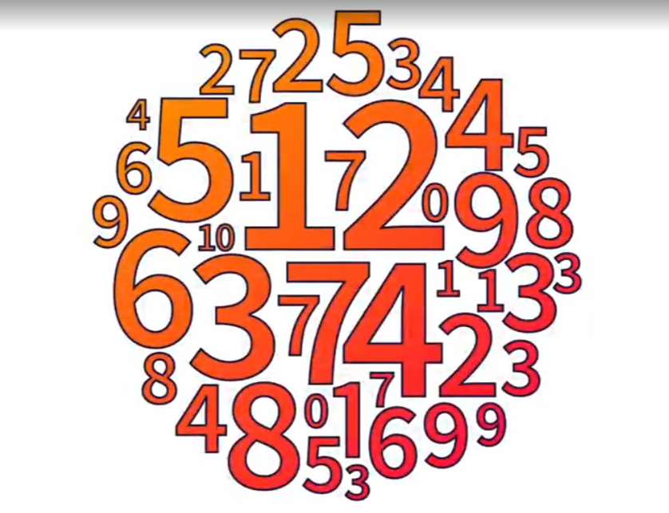
Upgrade 1: Using data and technology

Slide 22
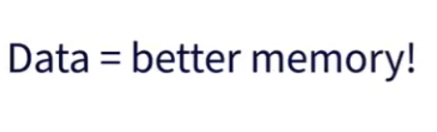
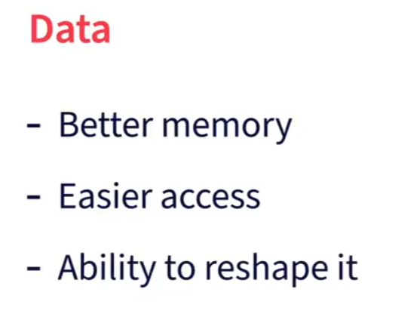
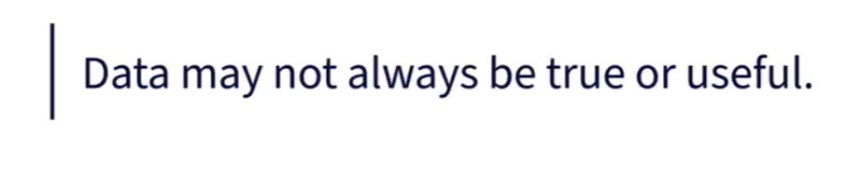
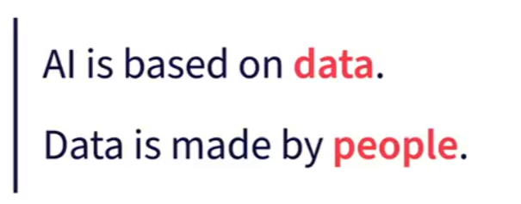

Upgrade 1: Using data and technology

Slide 23
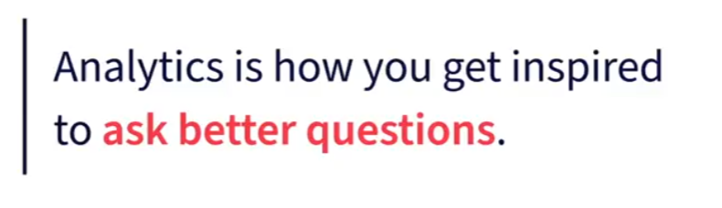
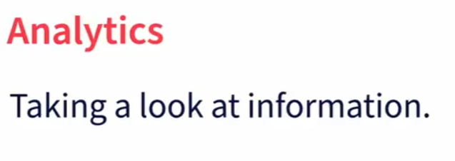
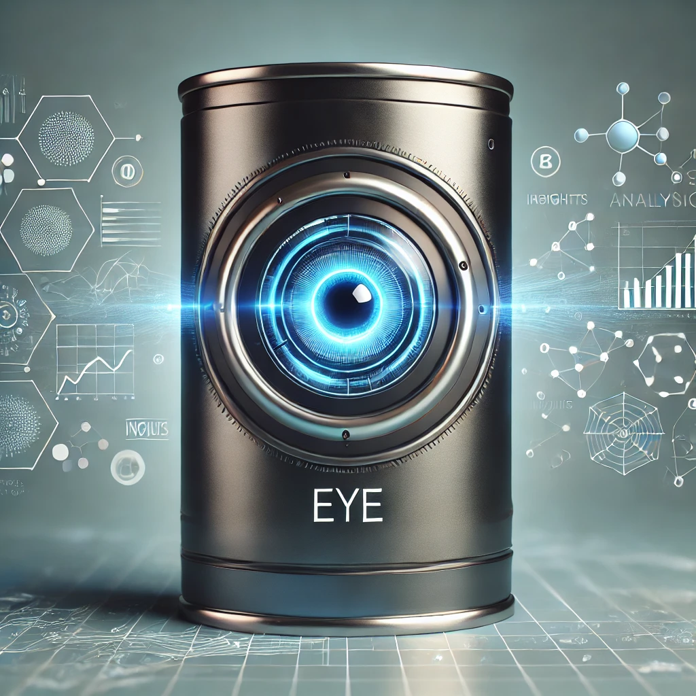

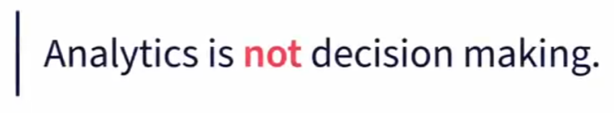
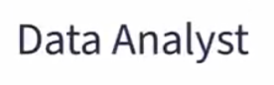
Upgrade 2: Better questions

Slide 24


Slide 25
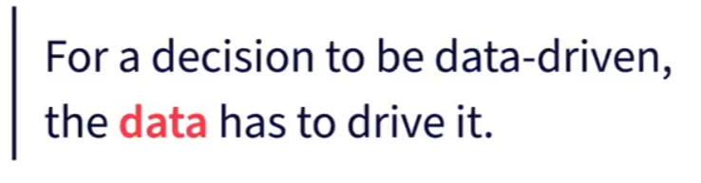
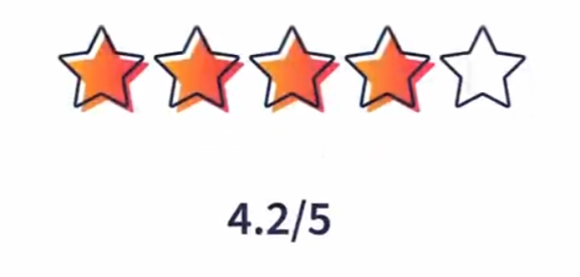
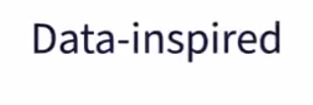
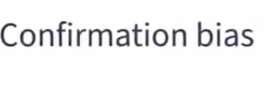
Upgrade 3: Data Driven decisions

Slide 26


Slide 27



Upgrade 3: Better answers
The default action

Slide 28


Slide 29

Upgrade 5: Decision Automation

Slide 30

Upgrade 5: Decision Automation

Slide 31


Slide 32


Slide 33


Slide 34


Slide 35


Slide 36


Slide 37


Slide 38

Un p-valor es la probabilidad de encontrar evidencia al menos tan condenatoria como la nuestra en un mundo donde la hipótesis nula es realmente cierta.

Slide 39


Slide 40


Slide 41


Slide 42




Slide 43


Slide 44





Slide 45


Slide 46


Slide 47


Slide 48


Slide 49


Slide 50


Slide 51


Slide 52


Slide 53


Slide 54


AI literacy and how to address your team's misconceptions AI's Cognitive Distortions
Computacional intellicenge

Slide 55


Slide 56


Slide 57


Slide 58


Slide 59


Slide 60


Slide 61


Slide 62


Slide 63


Slide 64


Slide 65


Slide 66


Slide 67


Slide 68


Slide 69


Slide 70
https://playground.tensorflow.org/

Slide 71


Slide 72


Slide 73


Slide 74




Slide 75


Slide 76


Slide 77



Slide 78


Slide 79


Slide 80



Slide 81



Slide 82




Slide 83


Slide 84

https://www.youtube.com/watch?v=FN2RM-CHkuI&ab_channel=JoshDarnit

Slide 85

Comunication Spectrum

Slide 86


Slide 87


Slide 88

The Kitchen Analogy

Slide 89



Slide 90


Slide 91


Slide 92


Slide 93


Slide 94



Slide 95


Slide 96



